Slide 1



Sri Adichunchanagiri Shikshana Trust(R) S J B Institute of Technology
Department of Electronics & Communication Engineering
A Mini project on
FIRE ALERT SYSTEM USING KEIL µvision AND PROTEUS
REVIEW - 01
Presented By
Student’s name [USN]
Nitin Nihal 1JB18EC063
Raj Kumar Singh 1JB18EC076
Sourav Chowdhary 1JB18EC095
Swayambhu Mohan Shukla 1JB18EC100
Under the guidance of
Mrs. UMA S.
Assistant Professor
Dept. ECE, SJBIT

Slide 2
CONTENTS
Introduction
Literature survey
Objective and scope
Software requirement
Components
Block diagram
Methodology
Advantages and Disadvantages
Application
Result
Conclusion
References

Slide 3
INTRODUCTION
Fire Alert System plays a vital role in our daily life, it is necessary to have a device that ensures safety against dangerous fire accident.
It is easy to install, since it is compact in size and does not occupies much of space. We can design several fire alert system through using different concepts and various components

Slide 4
LITERATURE SURVEY
Sl.no. | Source | Information Obtained
1 | Fakrulradzi Idris, Norlezah Hashim, , Ahmad Fauzan B. Kadmin, “Intelligent fire detection and alert system using labView”, in International Journal of Electrical and Computer Engineering (IJECE) , Vol. 9, No. 3, June 2019, pp. 1842~1849 | It provides the prototype of the intelligent fire detection and alert system and its operation
2 | Lei Zhang, and Gaofeng Wang “Design and Implementation of Automatic Fire Alarm System based on Wireless Sensor Networks“, in International Symposium on Information Processing, August 21-23, 2009, pp. 410-413 | The system can self-organize, real time monitor and report the smoke concentration and temperature in the surveillance region
3 | Faisal Saeed, Anand Paul, Abdul Rehman “IoT-Based Intelligent Modeling of Smart Home Environment for Fire Prevention and Safety” in J. Sens. Actuator Netw., 7(1), 2018, 11 | The simulation results showed that the system is able to detect early fire, even when a sensor is not working, while keeping the energy consumption of the sensors at an acceptable level.

Slide 5
OBJECTIVE AND SCOPE
The core objective of the project to design a fire alert system which can be used to prevent damage against fire accidents.
The scope is to give a visual output and sound confirmation that the fire has occurred.

Slide 6


SOFTWARE REQUIREMENT

Slide 7
COMPONENTS

Slide 8
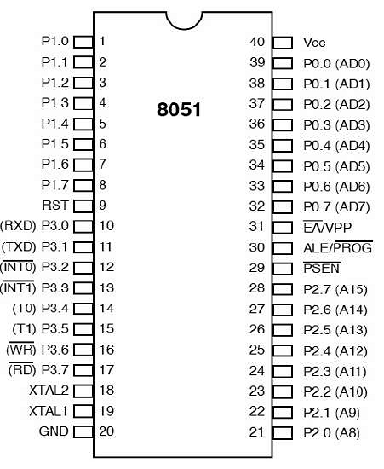

8051 MICROCONTROLLER

Slide 9
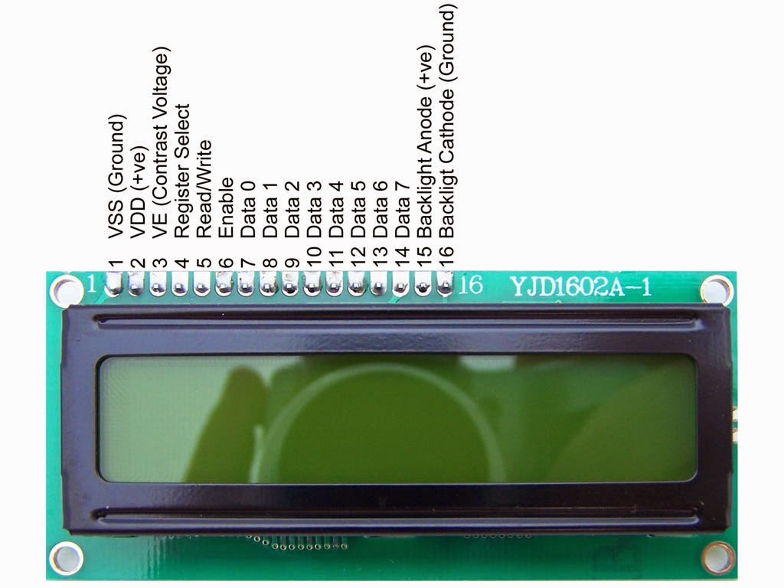
LCD SCREEN

Slide 10

BUZZER

Slide 11
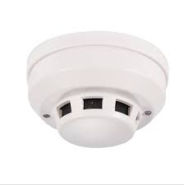
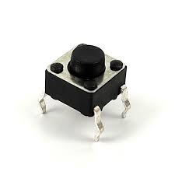
KEY / SENSER

Slide 12
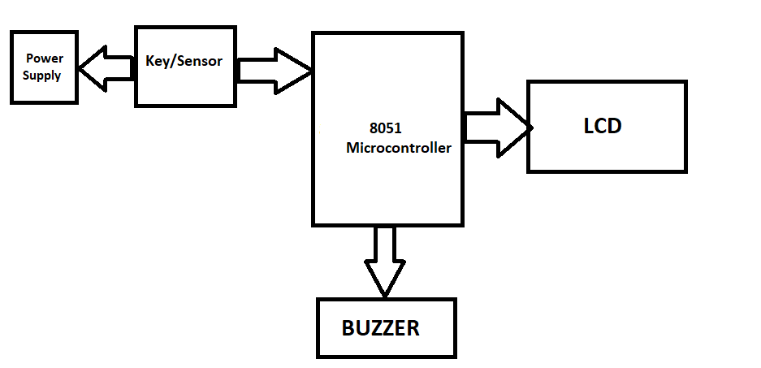
BLOCK DIAGRAM

Slide 13
METHODOLOGY
One end of the switch is connected to the power supply and the other end is connected to the P1.0 of the 8051 microcontroller.
The lcd is connected to the microcontroller.
One end of the buzzer is connected to the ground and the other end is connected to P3.0 of the 8051 microcontroller.
The lcd currently displays the message fire alert system.
When the key is pressed the buzzer starts ringing and lcd displays the message that the fire has occurred .

Slide 14
ADVANTAGES AND DISADVANTAGES
ADVANTAGES:
Early Fire Detection
Easy And Affordable
Low maintenance
Reduces Manpower
DISADVANTAGES:
Requires constant power supply.
Relatively high installation cost.

Slide 15
APPLICATIONS
School, Hospital, Institutional and Industrial sites.
Factories, Houses.

Slide 16
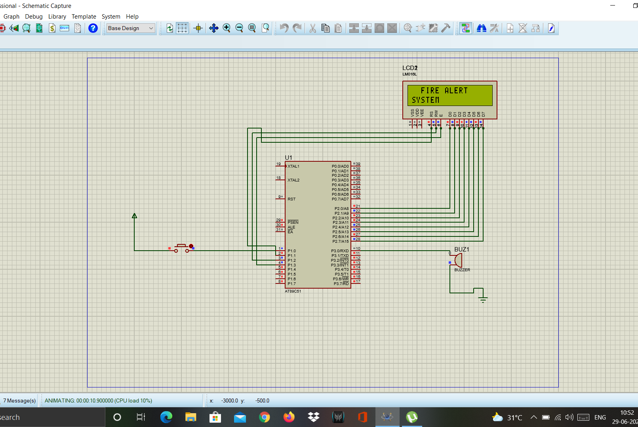

RESULT

Slide 17
CONCLUSION
A fire alert system has several devices working together to detect and warn people through visual and audio appliances software programming
Electronic circuits:
can be designed for the fire based alarms and they provide very high efficiency
can be used for the security reasons.
Early fire detection is best achieved by the installation and maintenance of fire detection equipment in all rooms and areas of the house or building.
we can evacuate the place as early as possible, and this could also help in finding an organized and safe way out.

Slide 18
REFERENCES
Fakrulradzi Idris, Norlezah Hashim, , Ahmad Fauzan B. Kadmin,“Intelligent fire detection and alert system using labView”, in International Journal of Electrical and Computer Engineering (IJECE), Vol. 9, No. 3, June 2019, pp. 1842~1849
Lei Zhang, and Gaofeng Wang “Design and Implementation of Automatic Fire Alarm System based on Wireless Sensor Networks“, in International Symposium on Information Processing, August 21-23, 2009, pp. 410-413
Faisal Saeed, Anand Paul, Abdul Rehman “IoT-Based Intelligent Modeling of Smart Home Environment for Fire Prevention and Safety” in J. Sens. Actuator Netw., 7(1), 2018, 11

Slide 19
THANK YOU

